Slide 1
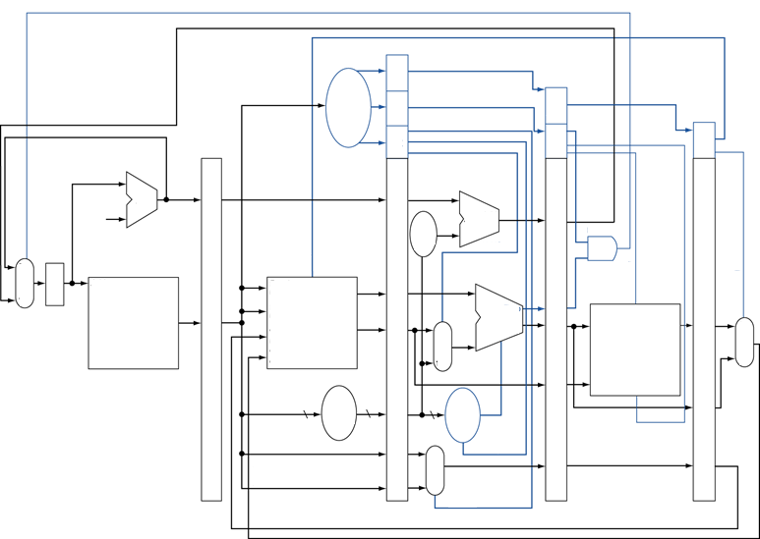
Name:_________________
ID/EX
WB
EX/MEM
Control
MEM
WB
MEM/WB
Show which lines are active when the instruction SW $t0, 4($s1) is executed
IF/ID
EX
MEM
WB
PC
Adder
Branch
Adder
2
Shift
Left
2
1
1
Branch
1
PC Mux
PC
5
1
5
1
1
Instruction
Memory
Register File
1
ALU
5
5
Mux
4
Data
Memory
Mux
16
Sign
Ext
6
ALU
Control
1
Mux

Slide 2
Name:_________________
ID/EX
WB
EX/MEM
Control
MEM
WB
MEM/WB
Show which lines are active when the instruction ADD $t0, $s1, $0 is executed
IF/ID
EX
MEM
WB
PC
Adder
Branch
Adder
2
Shift
Left
2
1
1
Branch
1
PC Mux
PC
5
1
5
1
1
Instruction
Memory
Register File
1
ALU
5
5
Mux
4
Data
Memory
Mux
16
Sign
Ext
6
ALU
Control
1
Mux

